Slide 1
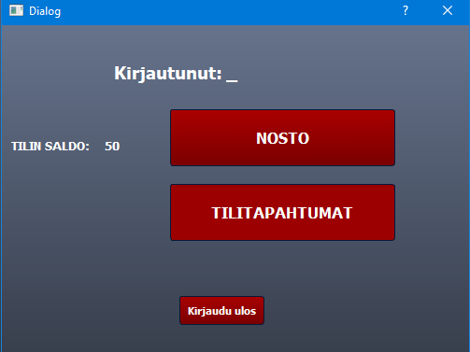
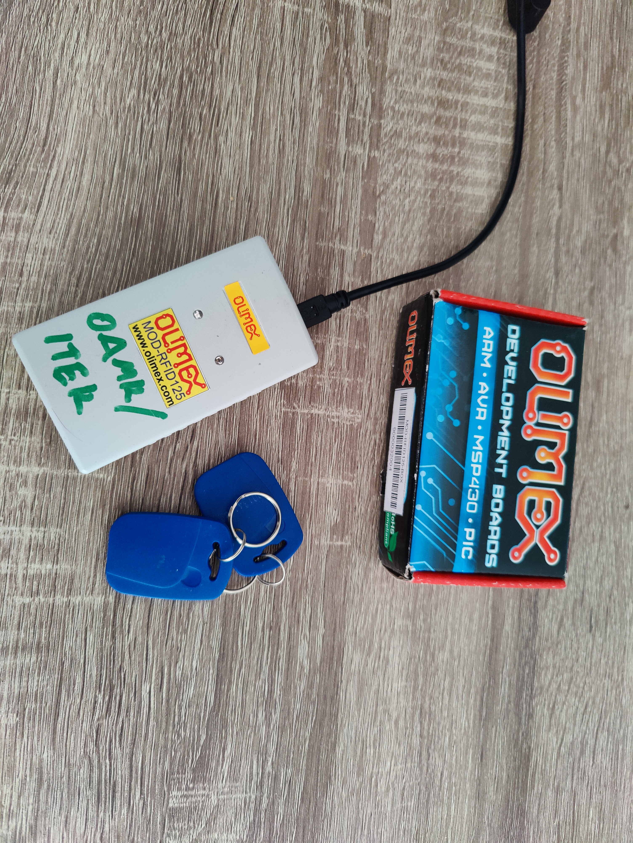
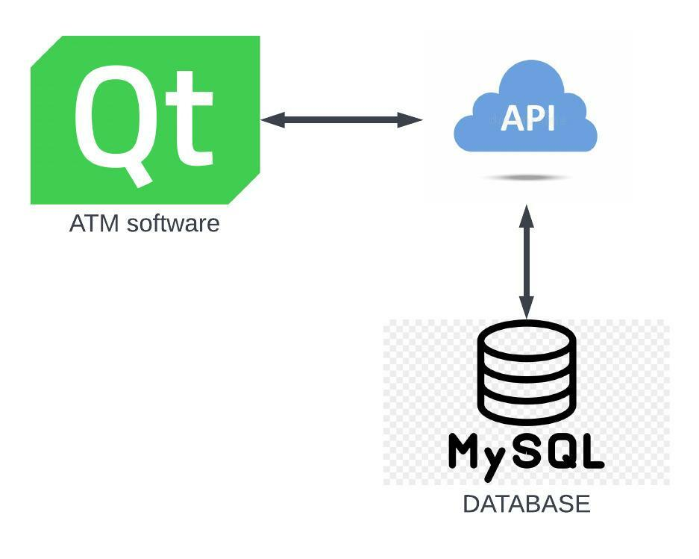
Pankkimaatti
Janne Ohtonen, Jere Ojala, Jukka Loppukaarre, Santeri Uusitalo, TVT21SPO
Information Technology, Software Development
Introduction
The aims of this project were to develop an application, which simulates an ATM, and learn skills required to get through the project.
Objectives
The objectives included building an ATM simulating desktop software, database and RestAPI, which stands for Representational state transfer application programming interface.
Database is needed to store all the information and data, desktop app to use and simulate the ATM, and RestAPI to communicate between the database and the desktop app. (Figure 1)
FIGURE 1. The architecture
Methods
The desktop software was made with Qt Creator using C++. It was also split into four sections, and compiled into one with Dynamic Linked Libraries. The first library included connections to the database with the api. The second library consisted of the RFID reader and RFID keys, (Figure 2) a pieces of hardware that were used simulate real debit card and card reader. The last library included the pin user interface.
All of the libraries were then added to the final section, to the executable program.
FIGURE 2. The RFID
Vaurious other tools were used during the project, like Git, Postman, UniServer, Mysql workbench and Visual Studio. All of the progress was updated to GitHub aswell.
Before coding itself was started, lots of documenting and project planning was made to help the developing later. These documents are also available on GitHub.
Results
The application works as planned. All the requirements are met, and the app is imporved visually. The documentations are finished.
FIGURE 3. The main ui
Conclusions
The project group is very pleased with the outcome of the project. Everyone learned a lot during the developing process, and not just coding, but problem solving and project management skills aswell.
References
1. RFID reader: https://www.olimex.com/Products/Modules/RFID/MOD-RFID125-BOX/
2. RFID keys: https://www.olimex.com/Products/Components/RFID-Tags/125/RFID125-KEY/
Software Application Project
ECTS Credits: 15
Date of publication: 2022, Spring
Instructors: Miisa Tanner, Jukka Jauhiainen

